Slide 1
Topic 12
Cache vs. hash
資料結構與程式設計
Data Structure and Programming
12/12/2018

Slide 2
From O(log n) to O(1) ?
For set and map, they have good complexity for “insert”, “delete” and “find” operations
➔ O(log n)
However, in set and map, all the data are sorted --
  Can output the data in ascending/descending order
  Can get the list of elements with values in certain range
What if we don’t care about the order, and just want to have fast “insert”, “delete” and “find” operations?
  Can we gain something (complexity) back for not sorting the data?

Slide 3
Hash Table
Buckets: the table is composed of B buckets (usually a large number)
Each bucket can hold up to S slots of data (usually a smaller number)
Given a data d with key x, a hash function h(x) is used to compute the corresponding bucket number
S slots
h(x)
(x, d)
d
B buckets

Slide 4
Hash Table Example
Record: (student name, score)
Hash table: 26 buckets
Hash function = the first character of name
h(x)
a
b
Bryant, 60
c
Charlie, 90
Chris, 78
d
Denny, 80
w
x
Is this a good hash function?
y
z

Slide 5
Complexity Analysis
Depending on how the s slots are designed
However, the worse case...
  Insert: O(1)
    Assuming it takes O(1) to compute h(x)
  Delete: O(s) → can they be O(log s)?
  Find: O(s) → what’s the price to pay?
Because s is usually a smaller number (e.g. 2) ➔ Very efficient

Slide 6
Hash Table Design Issues
Choice of hash function
Overflow handling methods
Size (number of buckets) of hash table

Slide 7
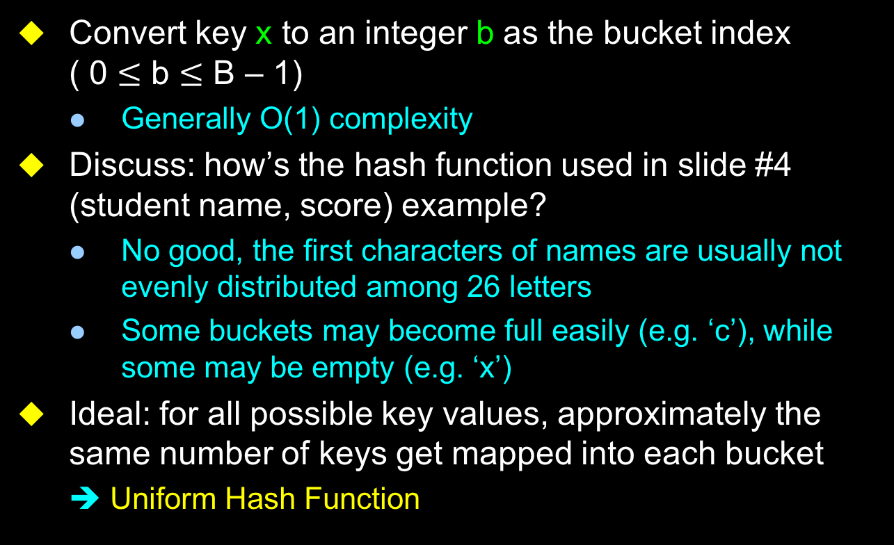
Hash Functions
Convert key x to an integer b as the bucket index
( 0 $≤$ b $≤$ B – 1)
  Generally O(1) complexity
Discuss: how’s the hash function used in slide #4 (student name, score) example?
  No good, the first characters of names are usually not evenly distributed among 26 letters
  Some buckets may become full easily (e.g. ‘c’), while some may be empty (e.g. ‘x’)
Ideal: for all possible key values, approximately the same number of keys get mapped into each bucket
  ➔ Uniform Hash Function

Slide 8
Hash Function Methods
Summation
  e.g. Adding the ASCII values of some/all the characters together
Shift
  e.g. Keys are pointers; because pointer values are multiplier of 4 (or 8)
  ➔ h(x) = (x >> 2) ...
  e.g. x.p, x.q are two pointers;
  ➔ h(x) = (x.p >> 3) + (x.q >> 6);
Division
  e.g. Divide a prime number
Others: folding, mid-square, digit analysis, etc
Usually: mixed of the above

Slide 9
Collision and Overflow
Collision
  Two non-identical keys are hashed into the same bucket
  At most (s – 1) collisions for a buckets
  Reduced by better hash function
Overflow
  When a new key is hashed into a full bucket
➔ For better hash performance,
we should try to produce less collisions and prevent overflow

Slide 10
Overflow Handling
Overflow may still happen when more and more data are stored into the hash
Open addressing
  Find a non-full bucket to insert the new key
  Linear probing, quadratic probling, rehashing, (pseudo)random probing, etc
Chaining
  Use linked list, dynamic array, or other kinds of ADT to make the s extendible

Slide 11
Hash Table Size
Hash table size (number of buckets) also affects the occurrence of overflow
  Too small ➔ Overflow happens
  Too large ➔ Waste of memory
Static hashing
  Fixed-size hash table
  Easier to implement; better if the number of possible elements is known in advance
Dynamic hashing
  Hash table size can grow when necessary
  When it grows, rehashing is needed

Slide 12
Hash Classes in STL
Static hashing, use set or map for the storage of each bucket
hash_set
hash_multiset
hash_map
hash_multimap
However, hash is NOT included as a standard package in newer platforms. You may need to do (For example) ---
  #include <hash_set.h> and/or
  g++ -I/usr/include/c++/4.0.0/backward/

Slide 13
class hash_set in STL
hash_set<Key[, HashFunc, EqualKey, Alloc]>
  class Key: element type
  class HashFunc: hash function (optional; default = hash<Key>)
  class EqualKey: equality checking for class Key (optional; default = equal_to<Key>)
  class Alloc: used for internal memory management (optional; default = alloc)

Slide 14
Member Functions of class hash_set
iterator begin() const;
iterator end() const;
size_type bucket_count() const;
void resize(size_type n);
pair<iterator, bool> insert(const value_type& x);
void insert(InputIterator f, InputIterator l);
void erase(iterator pos);
size_type erase(const key_type& k);
void erase(iterator first, iterator last);
iterator find(const key_type& k) const;
size_type count(const key_type& k) const;

Slide 15
Other Hash Classes in STL
class hash_multiset in STL
  Similar to hash_set, but allow elements with identical keys
class hash_map
  hash_map<Key, Data[, HashFunc, EqualKey, Alloc]>
class hash_multimap
  Similar to hash_map, but allow elements with identical keys

Slide 16
Hash Implementation Example (myHashSet.h)
Must overload:
operator () → as the hash function (i.e. d() % _numBuckets to return bucket index)
operator == → to compare if the data are equivalent (or have the same key)
template <class Data>
class HashSet
{
public:
class iterator
{
friend class HashSet<Data>;
};
private:
size_t _numBuckets;
// Each _buckets[i] is a vector<Data>
vector<Data>* _buckets;
};

Slide 17
Supported functions in class HashSet
iterator begin() const; // Point to the first valid data
iterator end() const; // Past the end
bool empty() const; // return true if no valid data
size_t size() const; // number of valid data
vector<Data>& operator [] (size_t i) { return _buckets[i]; }
const vector<Data>& operator [](size_t i) const;
void init(size_t b); // initialize Hash with _numBuckets = b
void reset();

Slide 18
Supported functions in class HashSet
// check if d is in the hash...
// if yes, return true; else return false;
bool check(const Data& d) const;
// query if d is in the hash...
// if yes, replace d with the data in the hash and return true;
// else return false;
bool query(Data& d) const;
// update the entry in hash that is equal to d (i.e. == return true)
// if found, update that entry with d and return true;
// else insert d into hash as a new entry and return false;
bool update(const Data& d);
// return true if inserted successfully (i.e. d is not in the hash)
// return false is d is already in the hash ==> will not insert
bool insert(const Data& d);

Slide 19
Another Hash Implementation Example (myHashMap.h)
template <class HashKey, class HashData>
class HashMap
{
typedef pair<HashKey, HashData> HashNode;
public:
class iterator
{
friend class HashMap<HashKey, HashData>;
};
private:
size_t _numBuckets;
vector<HashNode>* _buckets;
};

Slide 20

Another Hash Implementation Example (myHashMap.h)
class HashMap<HashKey, HashData>
All the HashNodes have the same bucketNum(), but distinct HashKeys
vector<HashNode>*_buckets
vector<HashNode>
HashNode
$≡$ pair<HashKey, HashData> (k, d)
_numBuckets
Usually a prime number
(Why?)
Overload operator () for HashKey as hash function
size_t bucketNum(const HashKey& k) const { return k() % _numBuckets; }

Slide 21
Class HashKey
To use Hash ADT, you should define your own HashKey class.
➔ It should at least overload the "()" and "==" operators.
  class HashKey // Of course, name your own HashKey
  {
  public:
  HashKey(); // define your own constructor
  size_t operator() () const; // acted as “hash
  // function”
  bool operator == (const HashKey& k);
  // to compare the HashKey
  private:
  // Define your own data members
  };

Slide 22
Example of using class Hash
Locating an address
typedef string Address;
typedef pair<float, float> Location;
class AddressKey {
public:
size_t operator() () const { ...; }
bool operator == (const Address& a) {
return (_addr == a._addr); }
private:
Address _addr;
};

Slide 23
class Hash::iterator
class iterator
{
friend class HashMap<HashKey, HashData>;
private:
// Define your own data members!!
};
Purpose: to go through the “valid” HashNodes in the Hash
To use:
  HashMap<HashKey, HashData> hh;
  ... // insert data
  HashMap<HashKey, HashData>::iterator hi = hh.begin();
  for (; hi != hh.end(); ++hi)
  cout << (*hi).first << “ → “ << (*hi).second
  << endl;

Slide 24
Supported functions in class HashMap
iterator begin() const; // Point to the first valid data
iterator end() const; // Pass the end
bool empty() const; // return true if no valid data
size_t size() const; // number of valid data
vector<HashNode>& operator [] (size_t i) { return _buckets[i]; }
const vector<HashNode>& operator [](size_t i) const;
void init(size_t b); // initialize Hash with _numBuckets = b
void reset();
bool check(const HashKey& k, HashData& n);
bool insert(const HashKey& k, const HashData& d);
bool replaceInsert(const HashKey& k, const HashData& d);
void forceInsert(const HashKey& k, HashData d);

Slide 25
Cache in Programming
Structurally similar to hash, however
  Usually smaller number of buckets
  Each bucket contains exactly 1 element
  When collision happens, the old data is overwritten by the new one
  Easier to implement than hash
Usually used as computational cache
  (input parameters) → computational results
There is no STL implement yet

Slide 26
Cache Implementation in util/myHashMap.h
template <class CacheKey, class CacheData>
class Cache
{
typedef pair<CacheKey, CacheData> CacheNode;
public:
// No need to implement class iterator (why?)
void init(size_t s);
void reset();
size_t size() const;
CacheNode& operator [] (size_t i);
const CacheNode& operator [](size_t i) const;
bool read(const CacheKey& k, CacheData& d) const;
void write(const CacheKey& k, const CacheData& d);
private:
size_t _size;
CacheNode* _cache; // new CacheNode[_size]
};

Slide 27
Example of using class Cache (BDD project)
Computed table
ITE(F, G, H) = F * G + F * H
F, G, H: BddNode (contains a size_t data)
  ➔ Requires expensive recursive calls to compute ITE() functions (O(|H|*|G|*|H|))
  ➔ The computed table (cache) is to record the result (as CacheData) with respect to the ITE parameters (as CacheKey)
  ➔ So next time when the same ITE(F, G, H) computation is required, we can immediately look up the cached result

Slide 28
FYI: Google Hash
http://code.google.com/p/google-sparsehash/
Two hashtable implementations:
  Sparse hash: designed to be space efficient
  Dense hash: designed to be time efficient
Interface very similar to SGI’s (STL) hash_map, hash_set, etc. But is claimed to be much more efficient.
  sparse_hash_map, sparse_hash_set, dense_hasp_map, dense_hash_set
  e.g. sparse_hash_map
  <Key, Data, HashFcn, EqualKey, Alloc>

